Slide 1
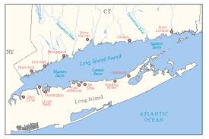
Old Field Point, Cranes Neck and West Meadow Beach Jetties
Talking Bass and Blues in our Backyard

Slide 2
What We Will Cover Today
Rods/Reels
Line
Bait
Artificials/Lures
Where to Go

Slide 3

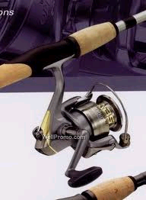




RODS and REELS
RODS & REELS
7’ to 9’
Length = distnce you can cast
Don’t need a “meat stick”
4000 series reel, nothing huge

Slide 4
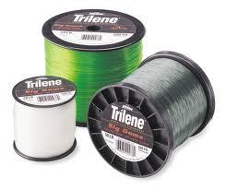
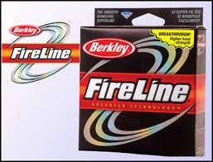

LINE
VS

Slide 5
HOW TO RIG IT
Small barrel swivel***
18” 40# leader material
Tactical angler clip
ITS JUST THAT SIMPLE

Slide 6
How To Fish It
TYLER 1
first 10 minutes 27-32
John Skinner
The Man knows how to fish the NS
Tyler 2

Slide 7
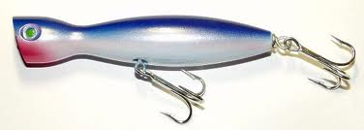
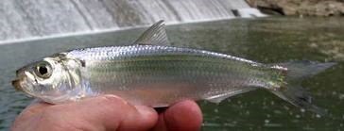
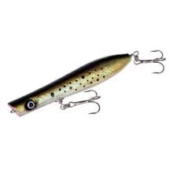
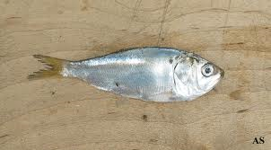
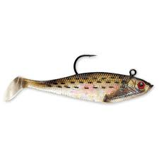
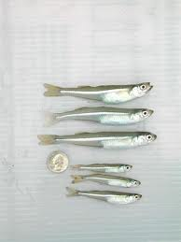
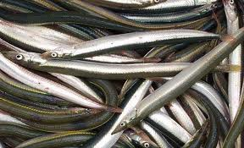

How To Pick Lures

Slide 8
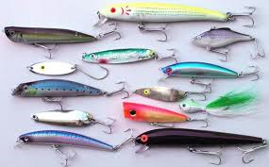
LURES TO ALWAYS HAVE

Slide 9
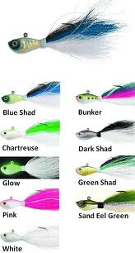
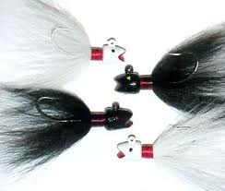
Bucktails
OR

Slide 10
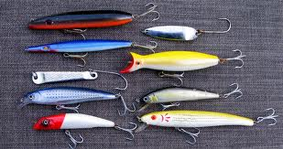
LURES TO ALWAYS HAVE

Slide 11
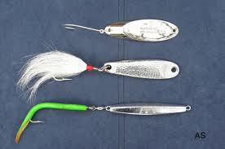
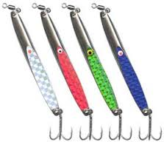
LURES TO ALWAYS HAVE

Slide 12
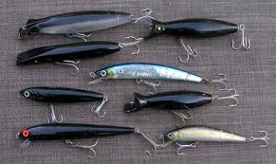
AND FOR AT NIGHT

Slide 13
What’s The Right Size Jig
Depends on location
  Current speed and depth are most important to consider
  Don’t always need bigger and heavier to reach the right spots!

Slide 14
WHERE TO GO FOR THEM
The Question everyone wants answered
But before we get to specific locations, what do all these have in common
  Know this and you can figure out new spots for yourself!!

Slide 15
WHERE TO GO FOR THEM
KNOW THE STRUCTURE
Fluke are fish that like to ambush its prey. Look at a map and figure out where this would be best

Slide 16
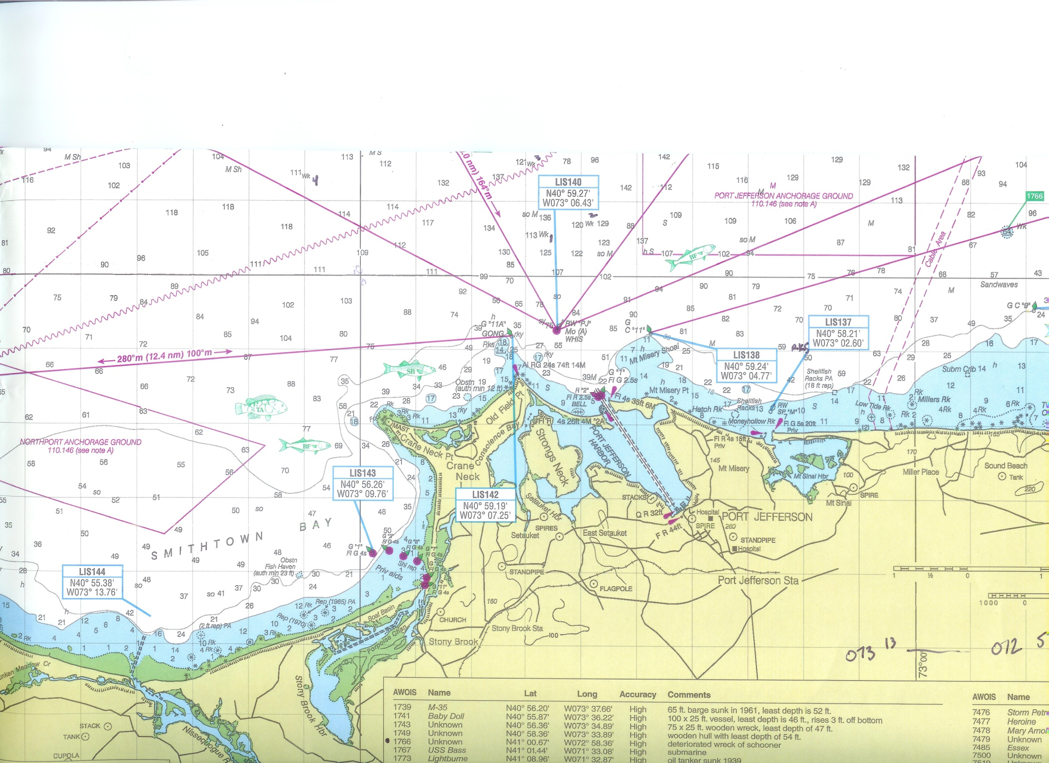

Slide 17
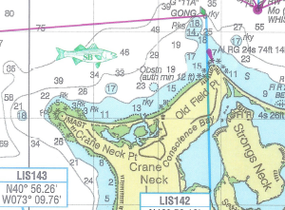
OLD Field PT to Cranes Neck

Slide 18
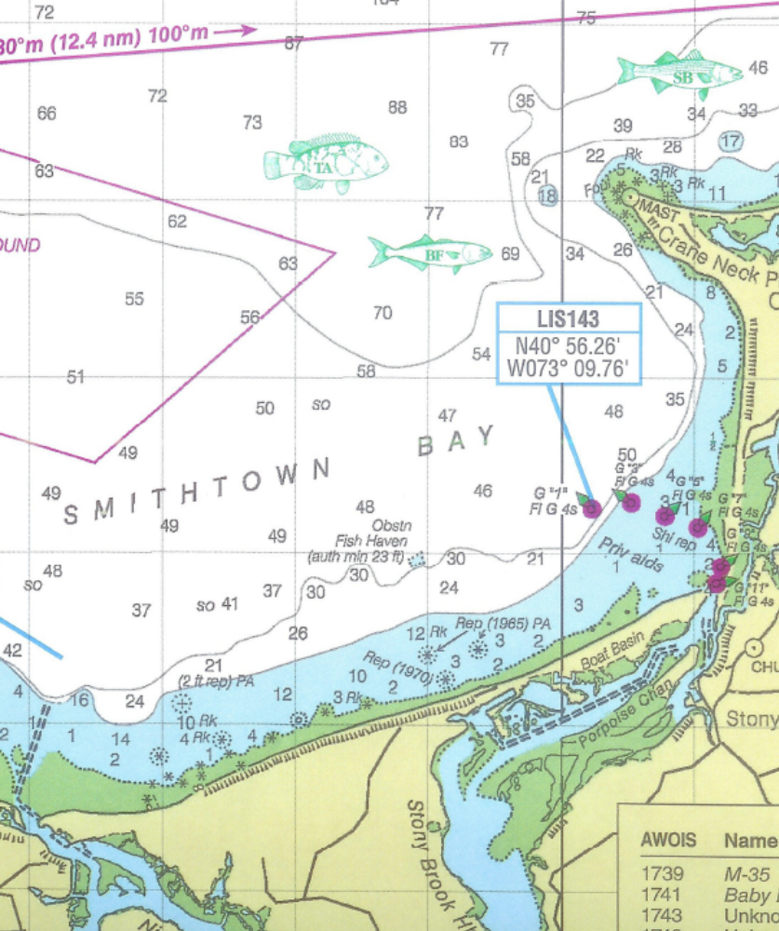
Smithtown Bay

