Slide 1



JIGGING
FOR STRIPED BASS
and BLUEFISH
RIGHT NOW!!
WMHS Fishing Club
Fire Island
Jones Inlet
And
Most oceaniac areas
Notes:
To view this presentation, first, turn up your volume and second, launch the self-running slide show.

Slide 2
Why not to pose for a picture at the side of the boat

Slide 3
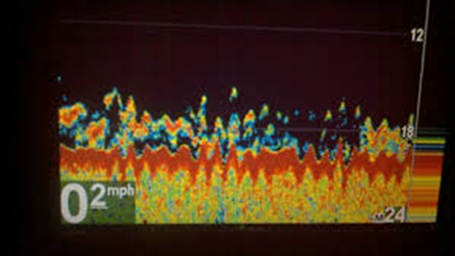
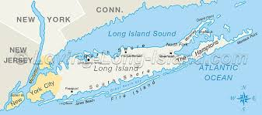
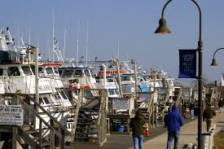
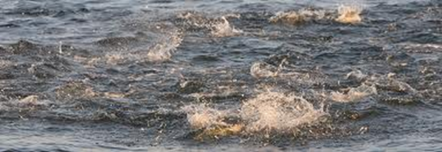
WHERE TO GO

Slide 4
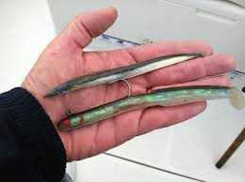
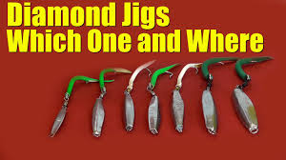
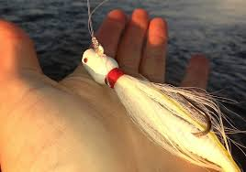
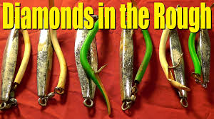
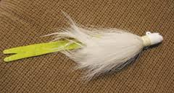
WHAT TO USE

Slide 5
What diamond jigging looks like

