Slide 1
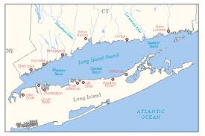
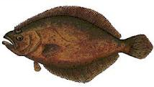
Light Tackle Fluke Fishing
ON THE LONG ISLAND SOUND

Slide 2
What We Will Cover Today
Rods/Reels
Line
Bait
Artificials/Lures
Where to Go

Slide 3
John Skinner Bucktailing Fluke

Slide 4

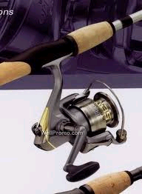




RODS and REELS
RODS & REELS
Think of your fresh water setups for ultra light setups.
Graphite rods give you sensitivity, composite rods take more abuse
Conditions and location will dictate how light you can go.
LIGHTER IS BETTER and MORE FUN!!!!
Match the reel to the size line you will be using.
If using spinning gear, make sure to get something with unlimited anti-reverse

Slide 5
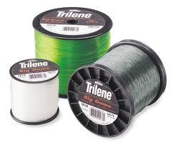
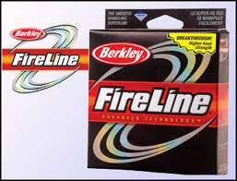

LINE
VS

Slide 6
HOW TO RIG IT
Use 15# to 20# leader.
On one end, tie in a 50 # to 75# swivel, on the other connect with a loop knot or duo clip to the jig head
Several variations to choose from
  Jiggsy Rig
  Straight shot
  Teaser Chain
  Fishing Ball Rig
      Displayed on poster board

Slide 7
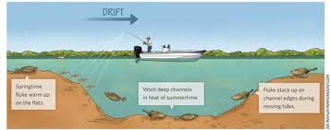
How To Fish It
SCOPE is important. Can be the difference between catching and not

Slide 8

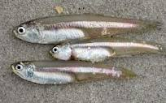
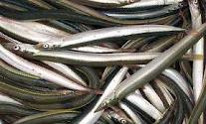
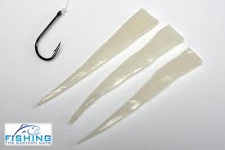
BAIT
Just for adding on “flavor” to tip your bucktail jig
Killies
Spearing (shiners)
Sand Eels
Squid

Slide 9

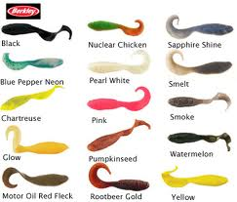
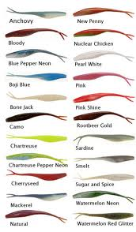
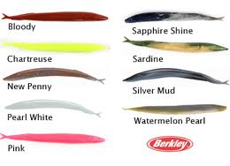
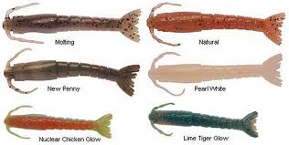
BAIT TO USE

Slide 10
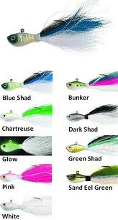
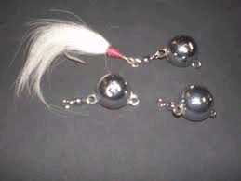
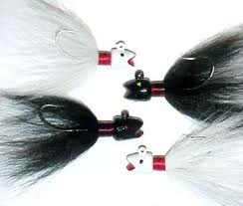
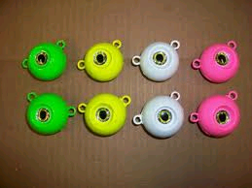
ARTIFICIALS / LURES
Just remember that for fluke, keep the sizes in the ranges of ¼ oz. to 2 oz. for bucktail jigs. For Fishing balls, larger can be acceptable.

Slide 11
What’s The Right Size Jig
Depends on location
  Current speed and depth are most important to consider

Slide 12
WHERE TO GO FOR THEM
The Question everyone wants answered
But before we get to specific locations, what do all these have in common
  Know this and you can figure out new spots for yourself!!

Slide 13
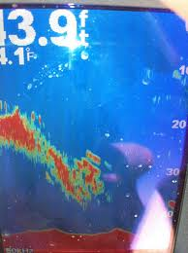
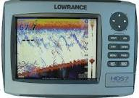
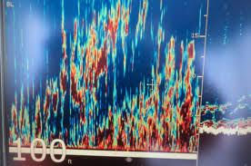
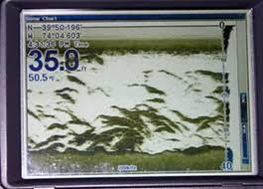
WHERE TO GO FOR THEM
FIND THE BAIT

Slide 14
WHERE TO GO FOR THEM
KNOW THE STRUCTURE
Fluke are fish that like to ambush its prey. Look at a map and figure out where this would be best

Slide 15
SPECIFIC SPOTS
BOUY 7
BOUY 9
BOUY 11
PINK HOUSE
FLAX POND
OLD FIELD POINT
CRANES NECK
SMITHTOWN BAY

Slide 16
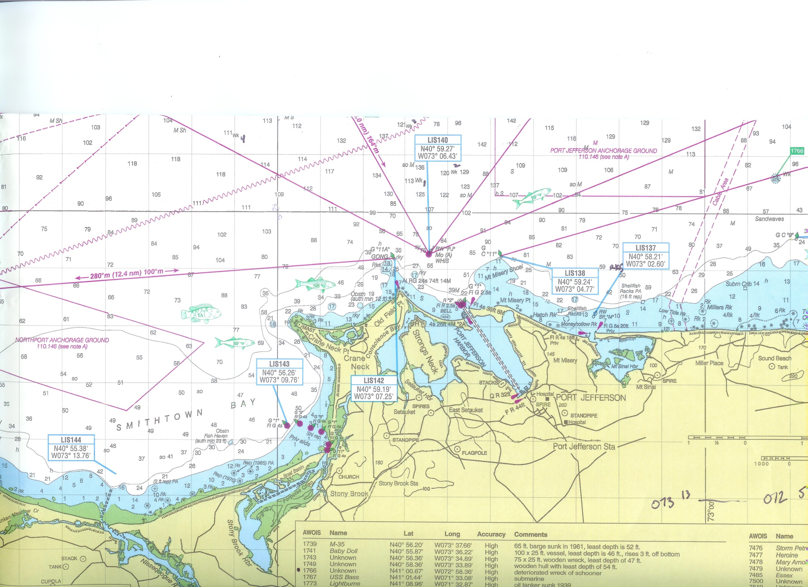

Slide 17
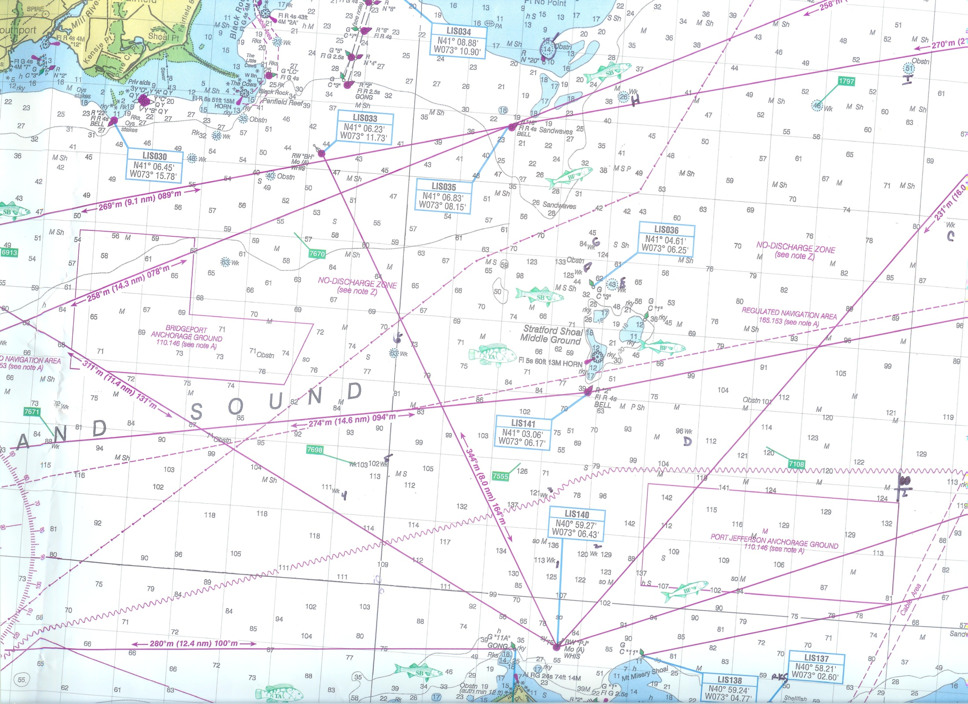

Slide 18
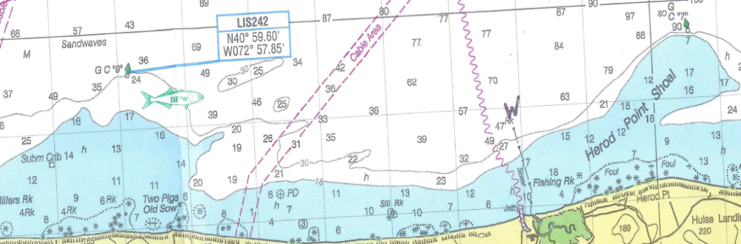
Buoys 7 and 9

Slide 19
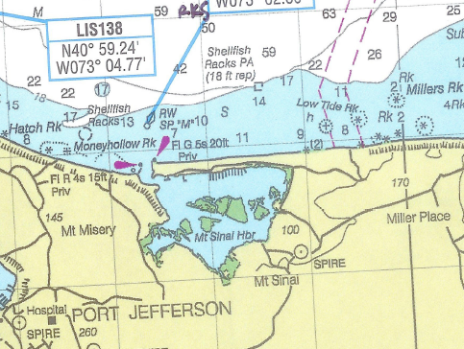
MT. Sinai Area

Slide 20
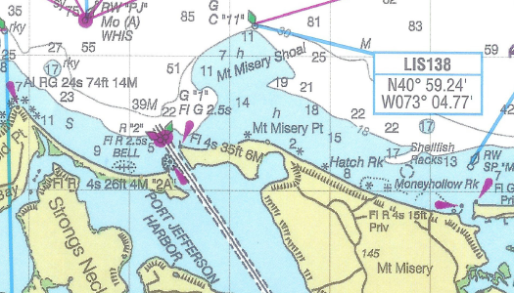
Buoy 11 – Mt Misery Shoal

Slide 21
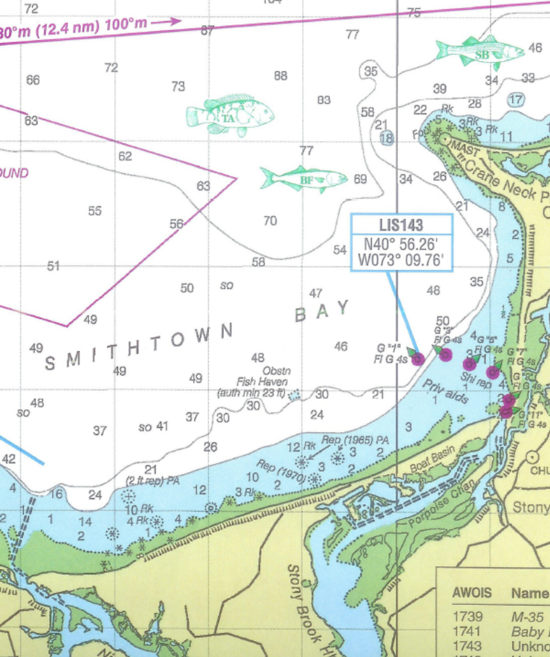
Smithtown Bay

Slide 22
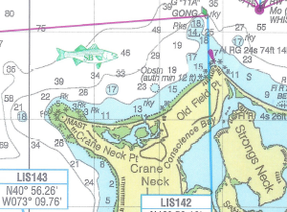
OLD Field PT to Cranes Neck

Slide 23
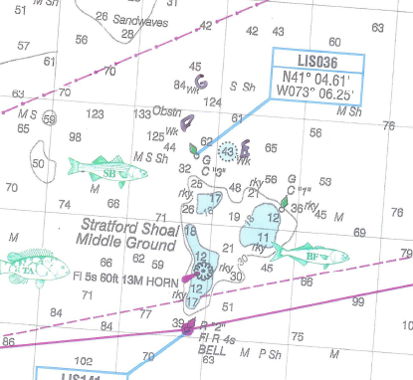
The Middle Grounds

Slide 24
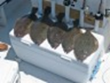
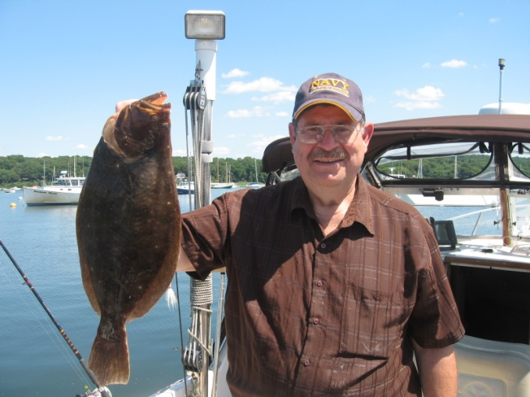

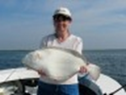
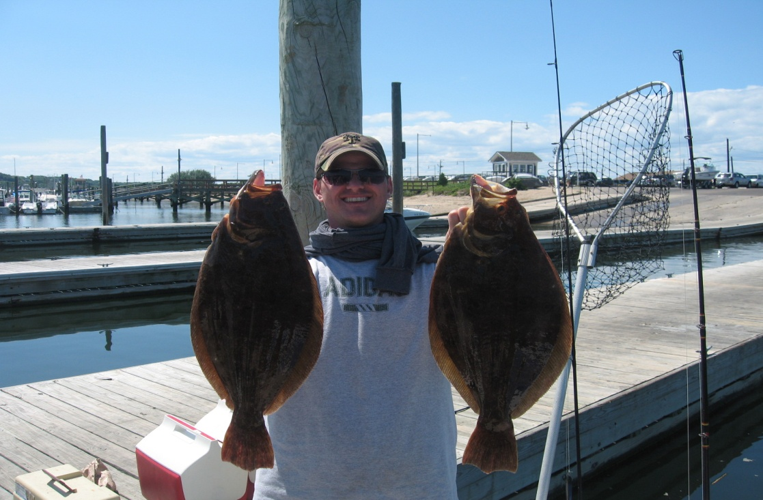

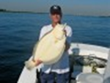
PICTURES OF FISH ON LIGHT TACKLE JIGS

Slide 25
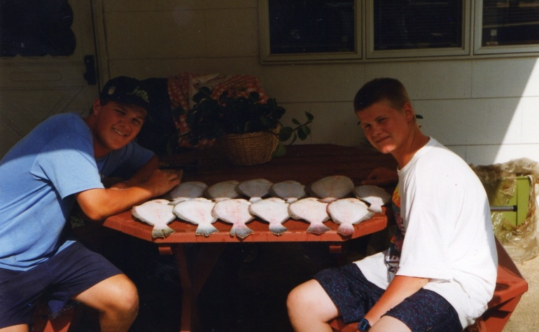
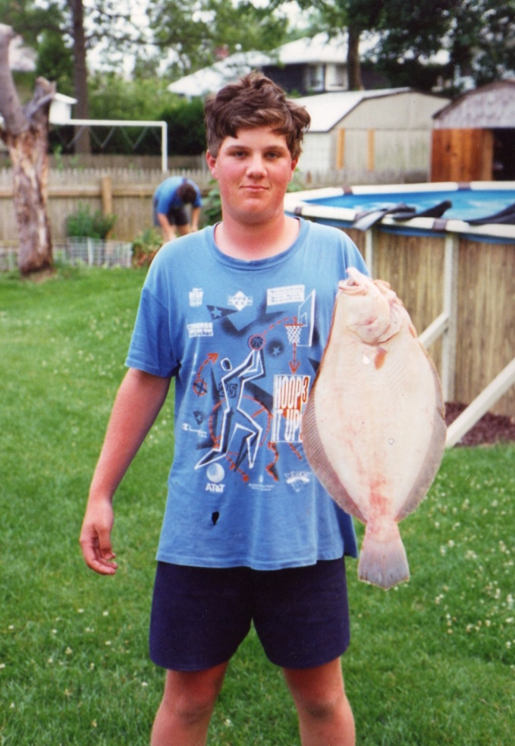
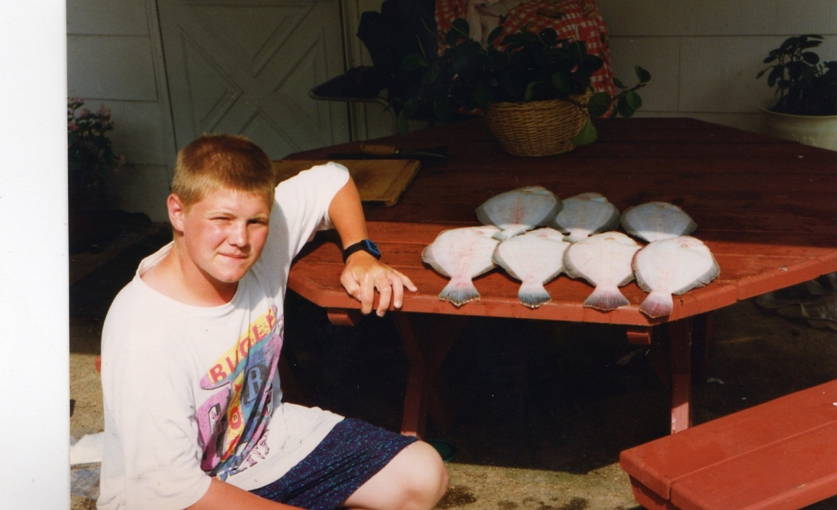
EARLY ON PICS ON LIGHT TACKLE JIGS

Slide 26
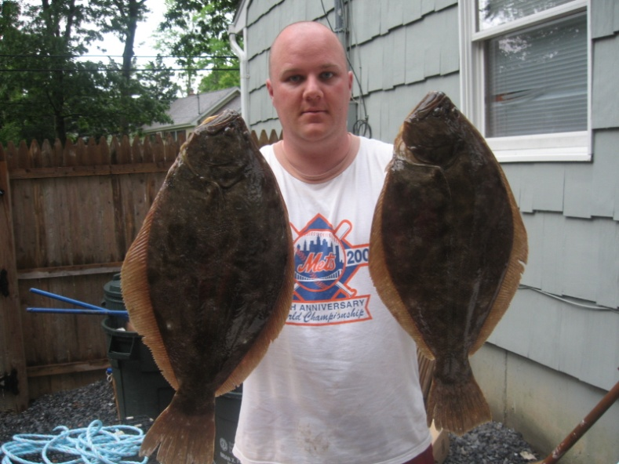
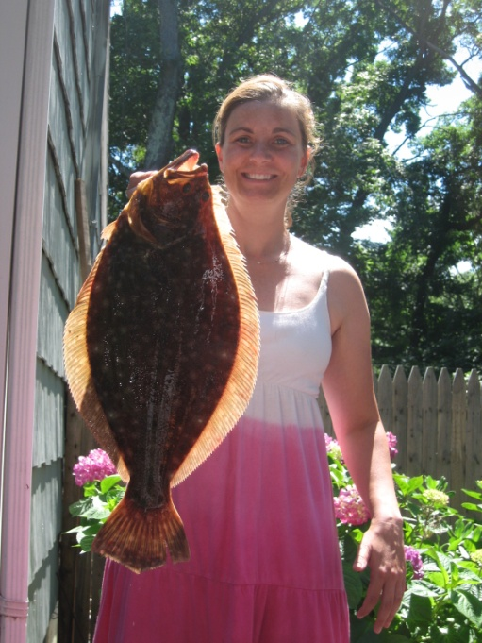
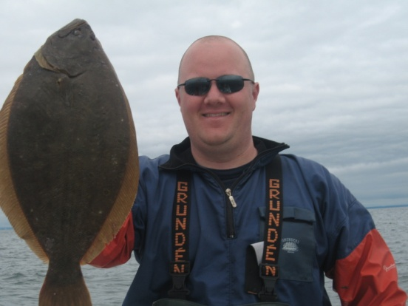
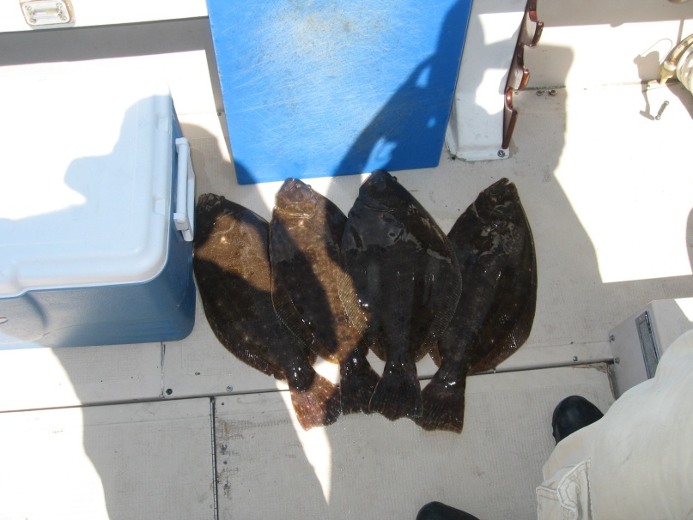
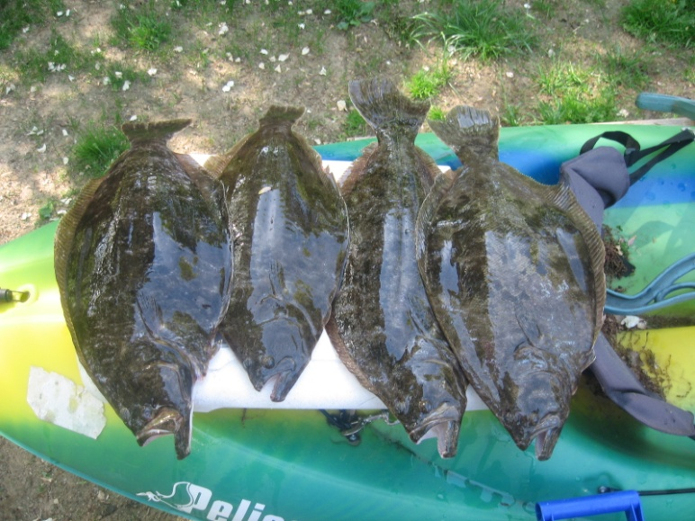
PICTURES OF FISH ON LIGHT TACKLE JIGS

Slide 27
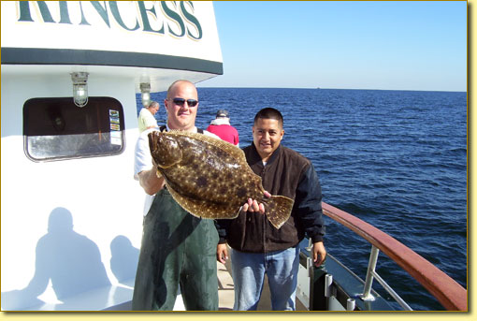
Always Remember….

