Slide 1
PORGY FISHING
Fishing not only off a boat in Long Island Sound but also from the beach where we have access

Slide 2
VIDEOS
Catching porgies

Slide 3
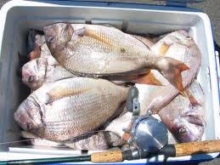
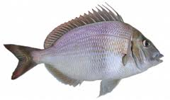
What we are Catching

Slide 4
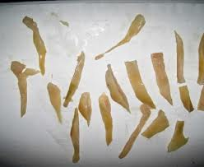
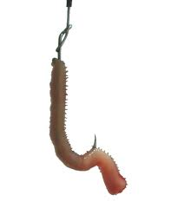
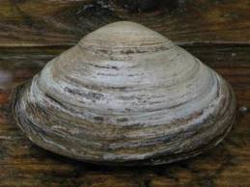
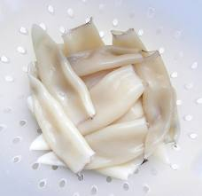
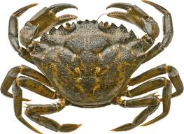
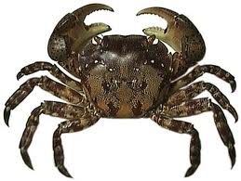
Baits to Use

Slide 5
Where to Find Them
THE QUESTION EVERYONE WANTS ANSWERED NOW!!!
The answer is:
…….
Around structure!!
(ok, I’ll be a bit more specific)

Slide 6
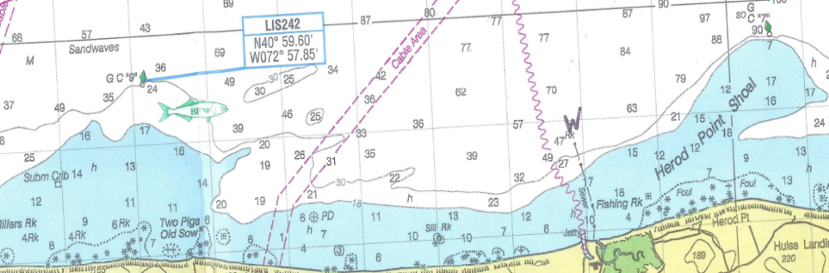
Buoys 7 and 9

Slide 7
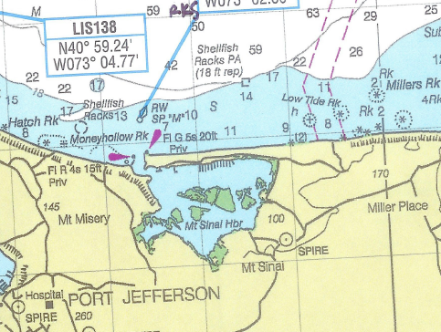
MT. Sinai Area

Slide 8
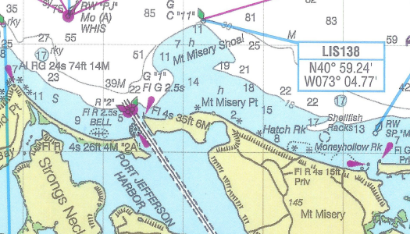
Buoy 11 – Mt Misery Shoal

Slide 9
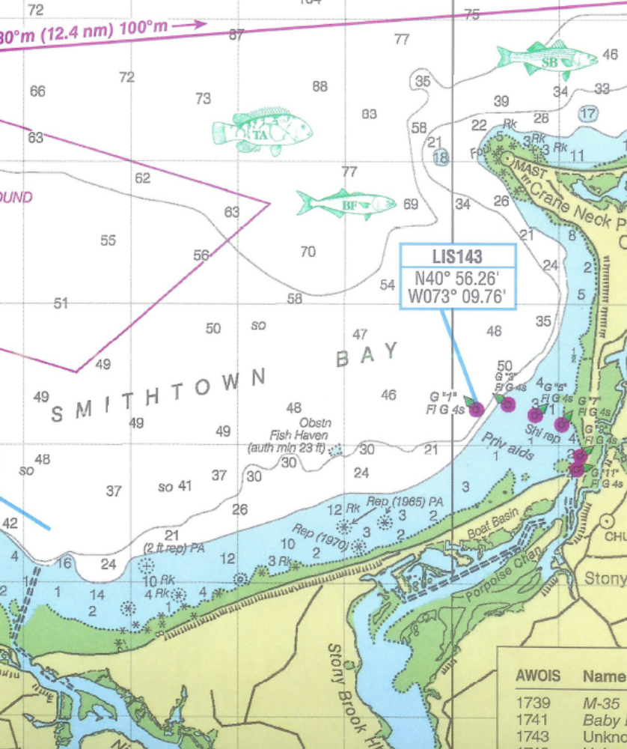
Smithtown Bay

Slide 10
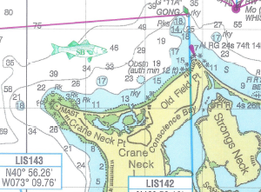
OLD Field PT to Cranes Neck

Slide 11
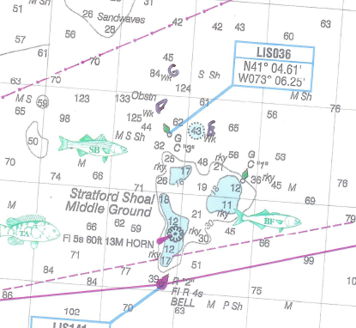
The Middle Grounds

Slide 12
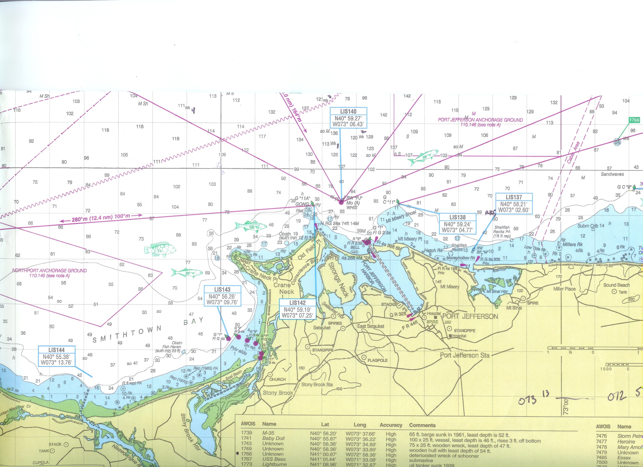

Slide 13
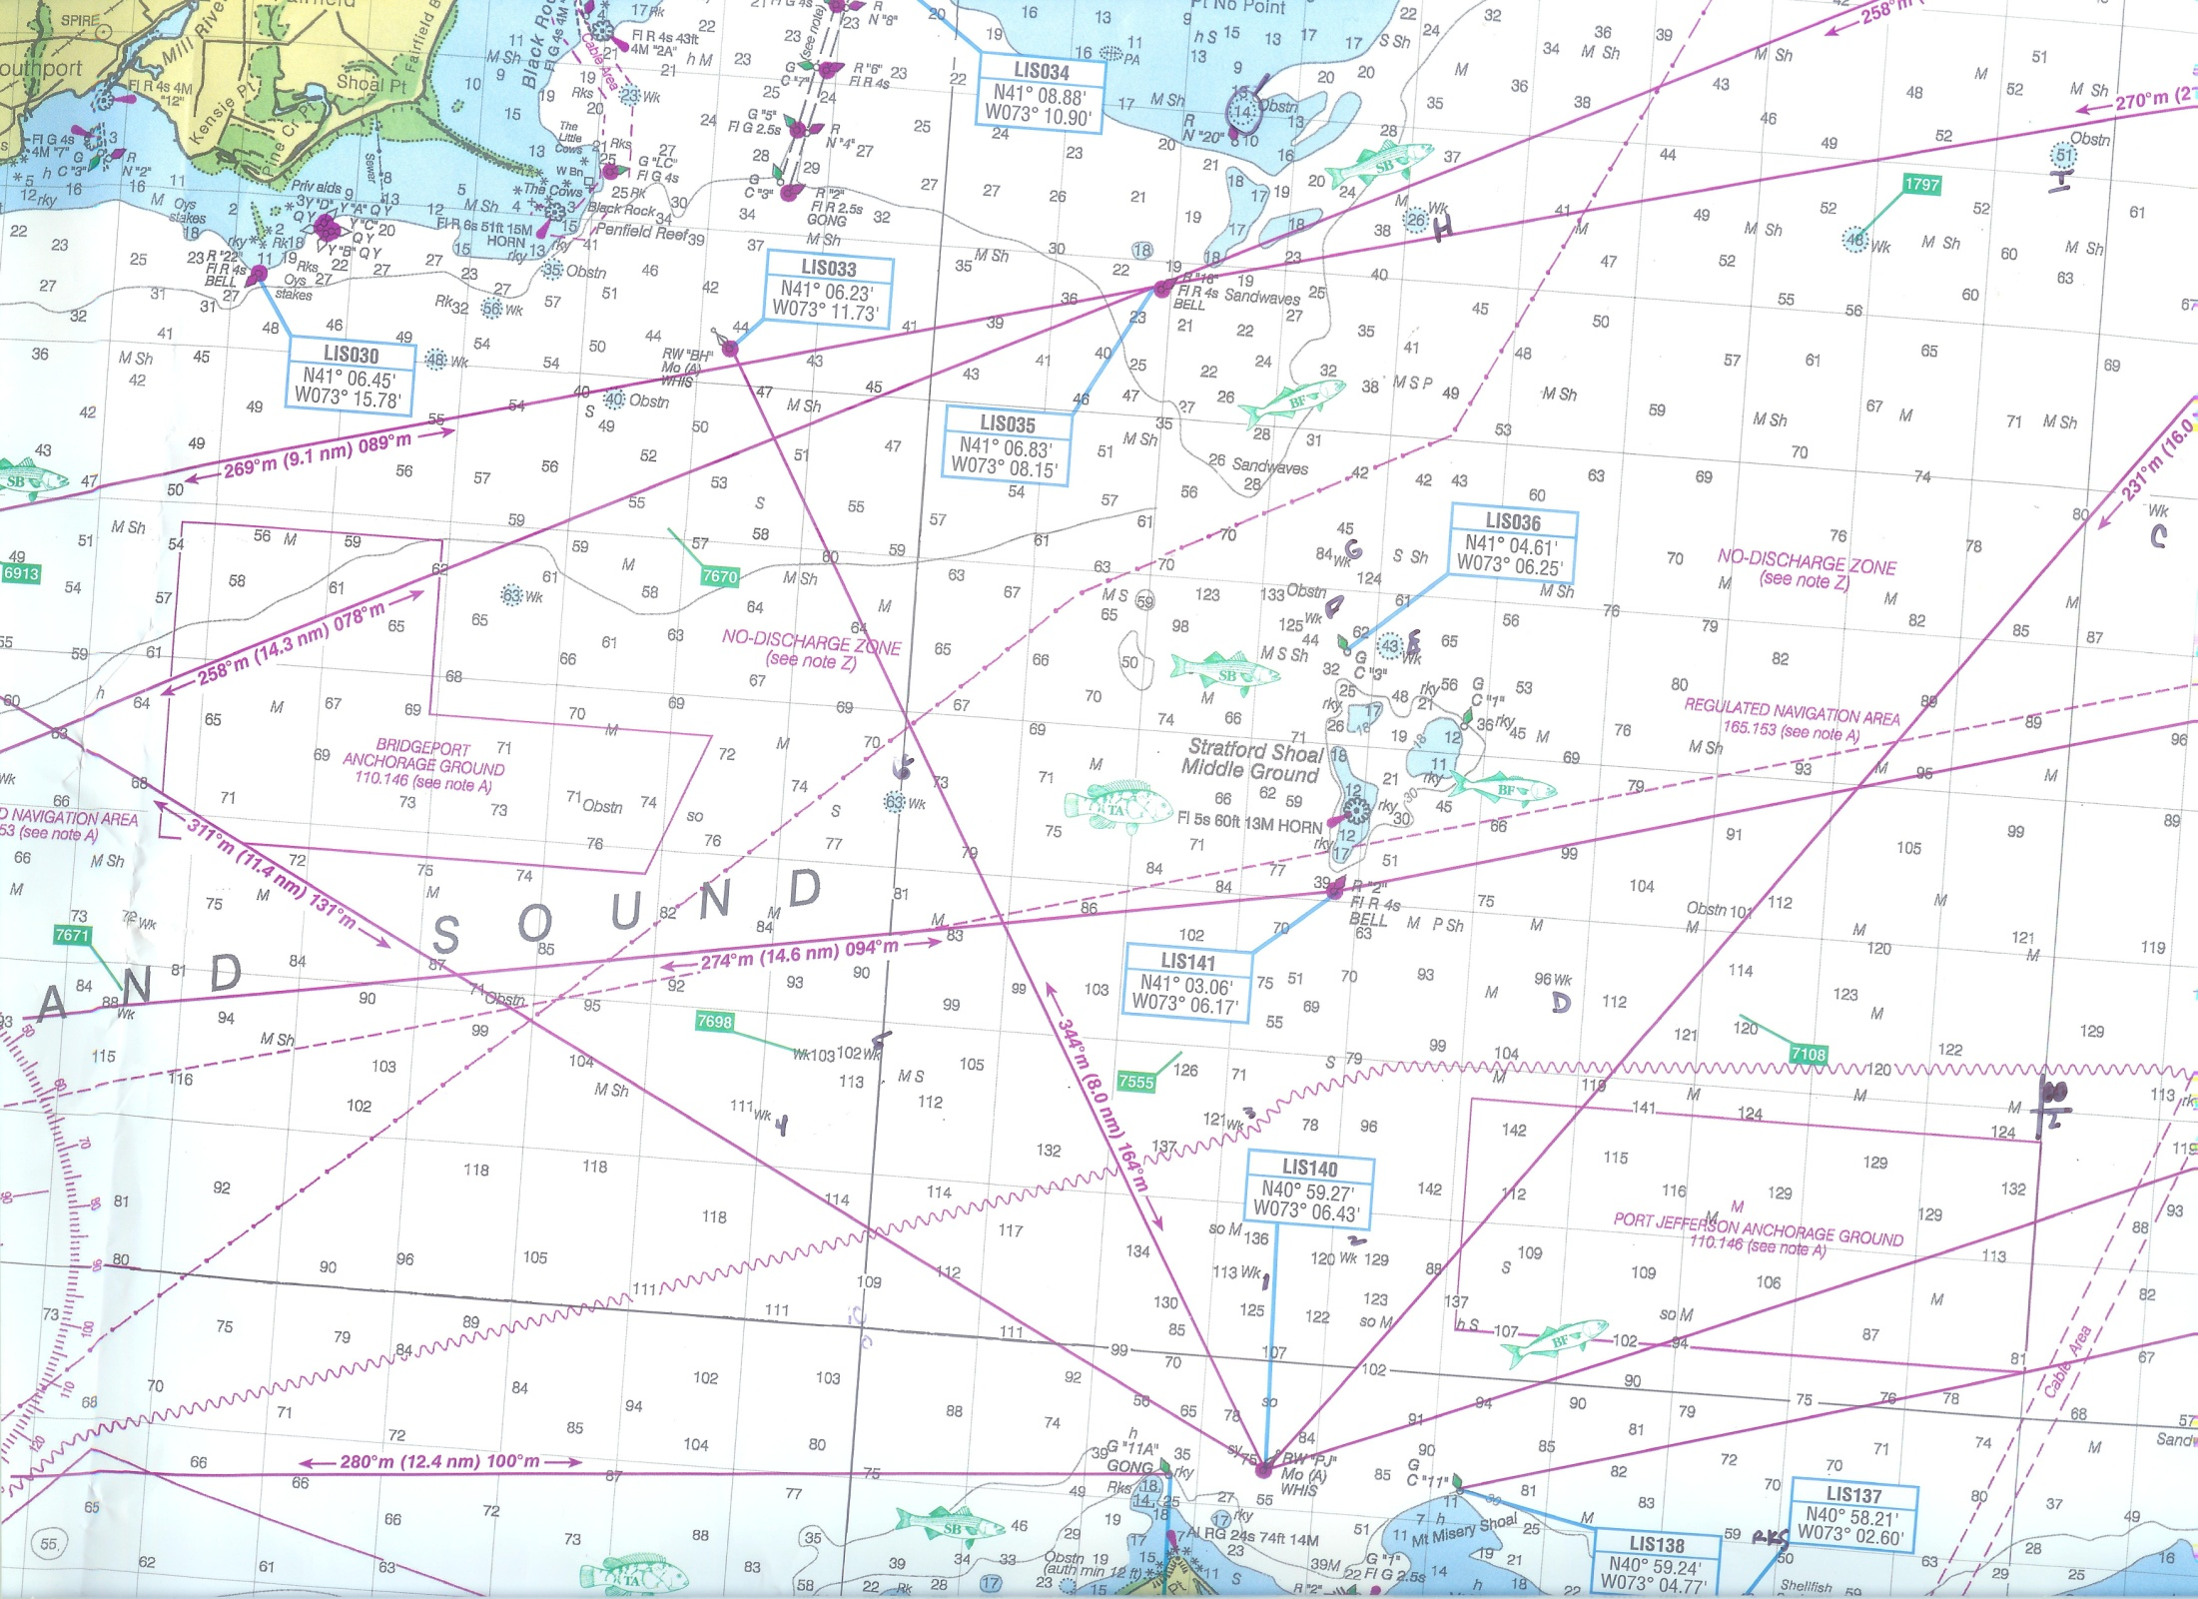

Slide 14
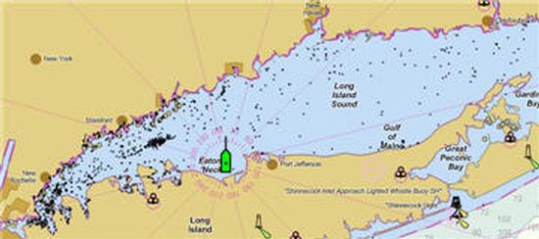

Slide 15
How to Catch Them
Tips for Blackfish Blackfish Instr -1
Blackfish Instr -2
Catching porgies
Jigging Blackfish

