Slide 1
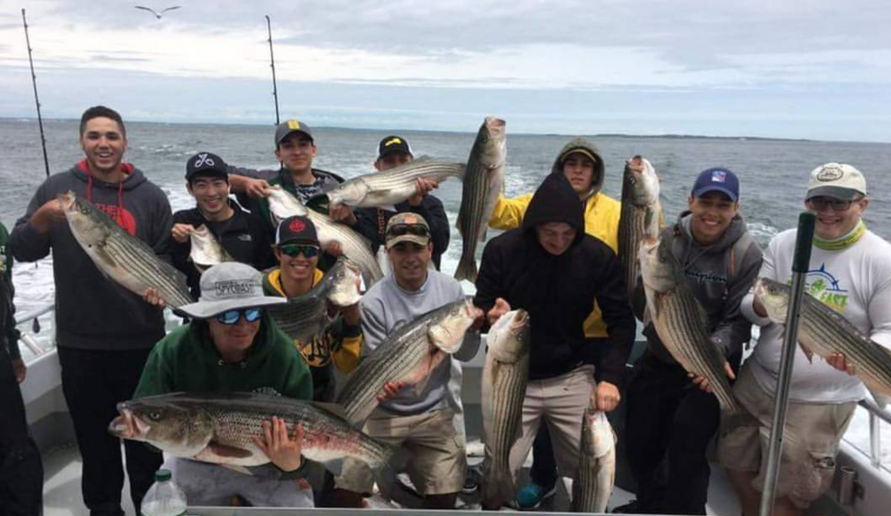
STRIPED BASS FISHING

Slide 2
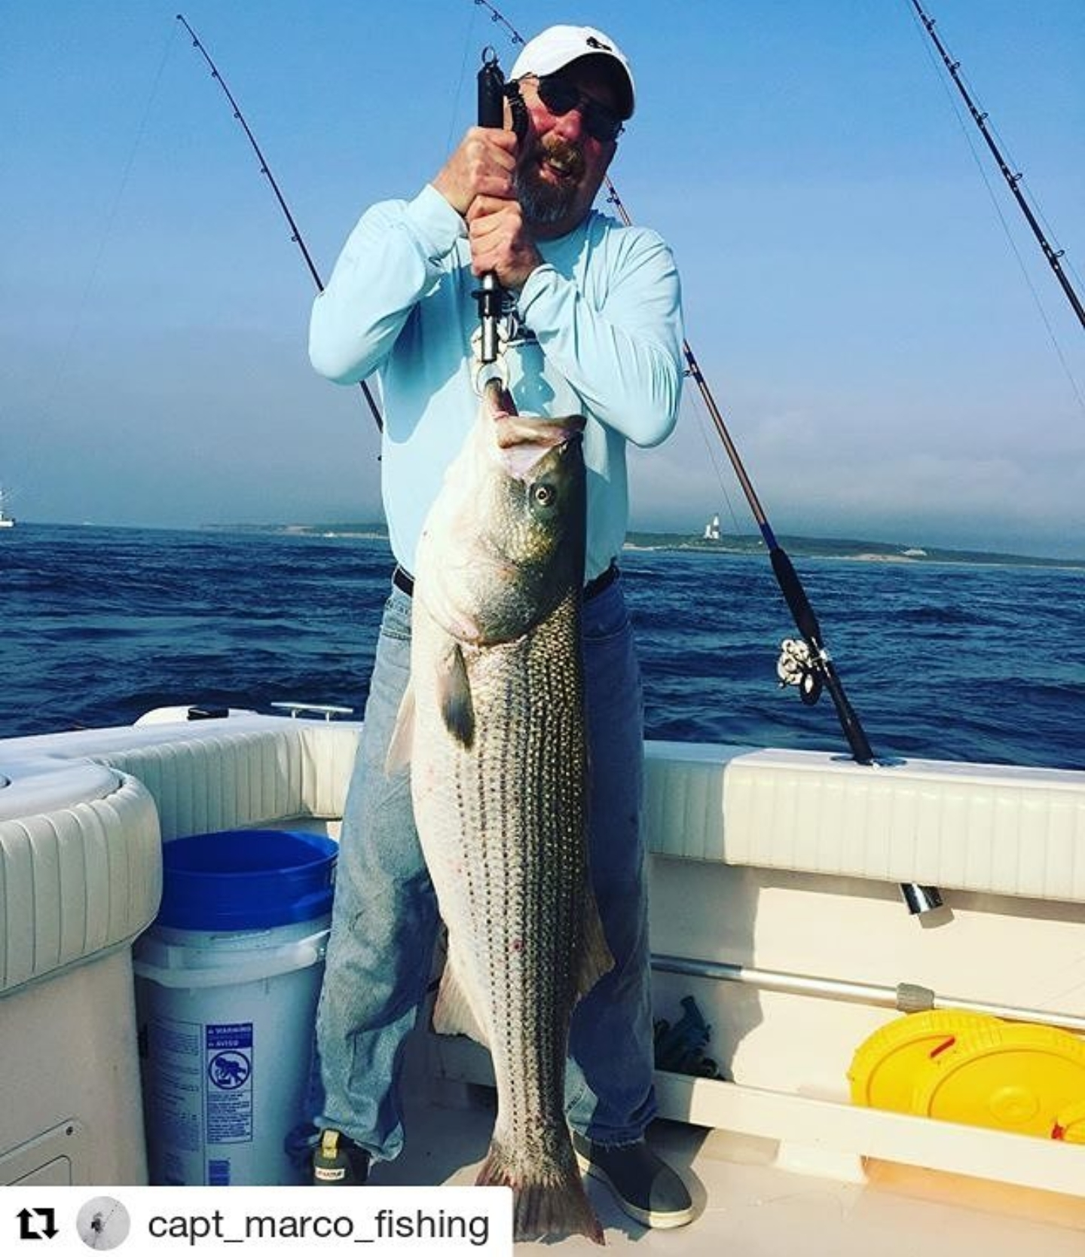
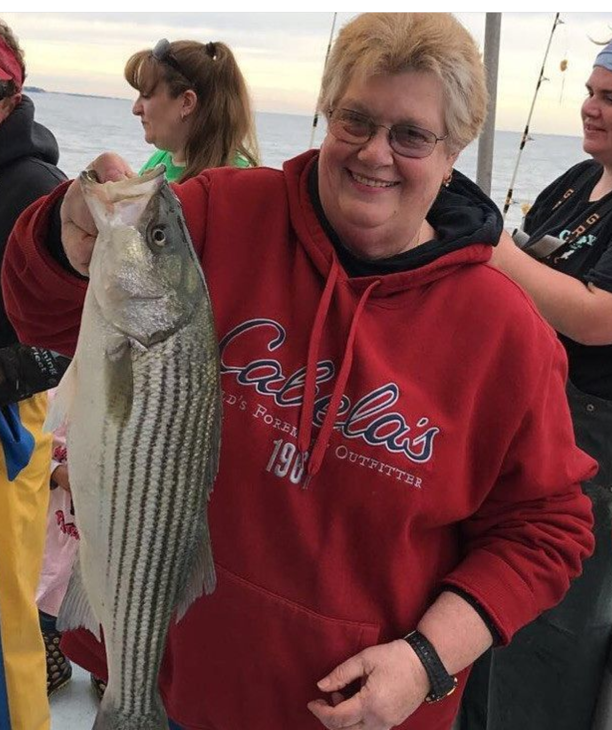
Its So Easy …. Even Librarians can do it

Slide 3
But you need to know some basics….
LOCATION DISCTATES OFTEN HOW YOU FISH
North Shore surf
North Shore Boat
East End Boat
MATCH THE HATCH
KNOW YOUR TIDES & MOONS

Slide 4
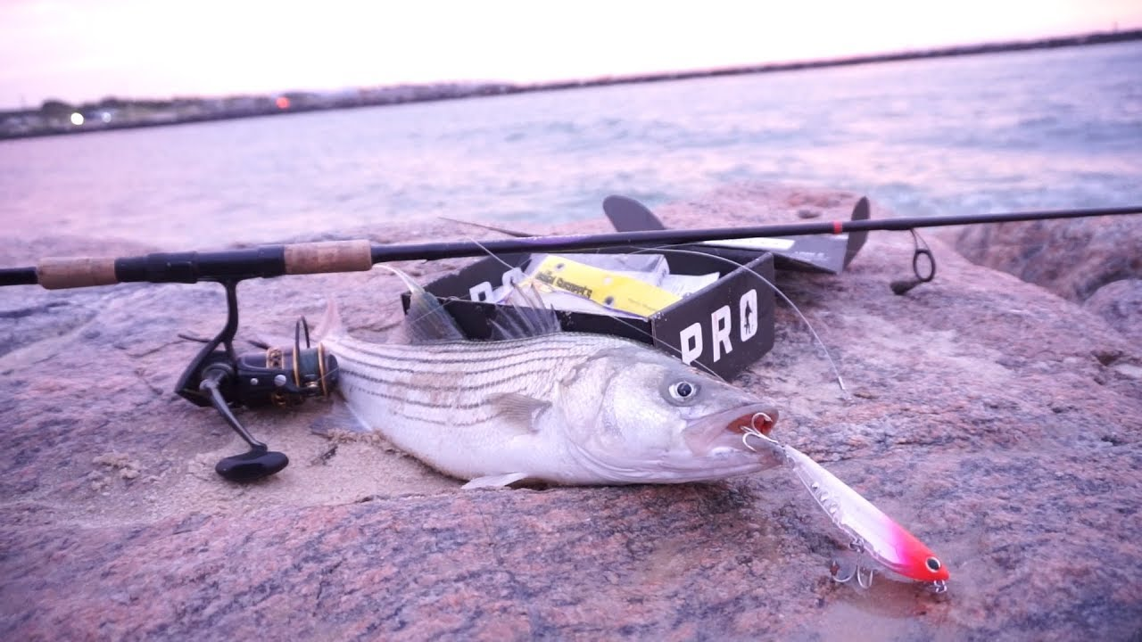
NORTH SHORE SURF
Rods
  7’ to 9’ Rod ML to M action
Reels
  “4000” sized reel
Line
  15# to 25# test Lighter is easier to cast but when you have to turn a big girl….
Lures
  Smaller sized lures

Slide 5
HOW TO RIG IT
Small barrel swivel***
18” 40# leader material
Tactical angler clip
ITS JUST THAT SIMPLE

Slide 6
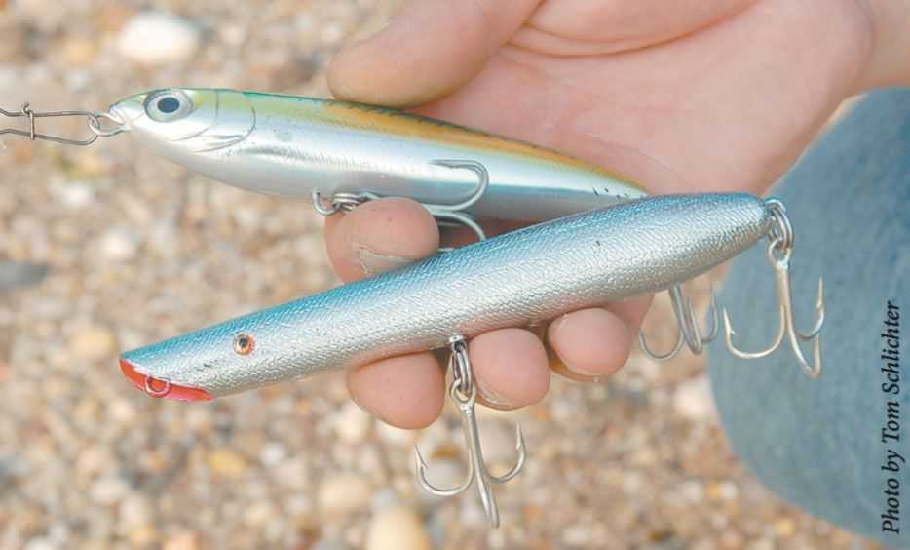
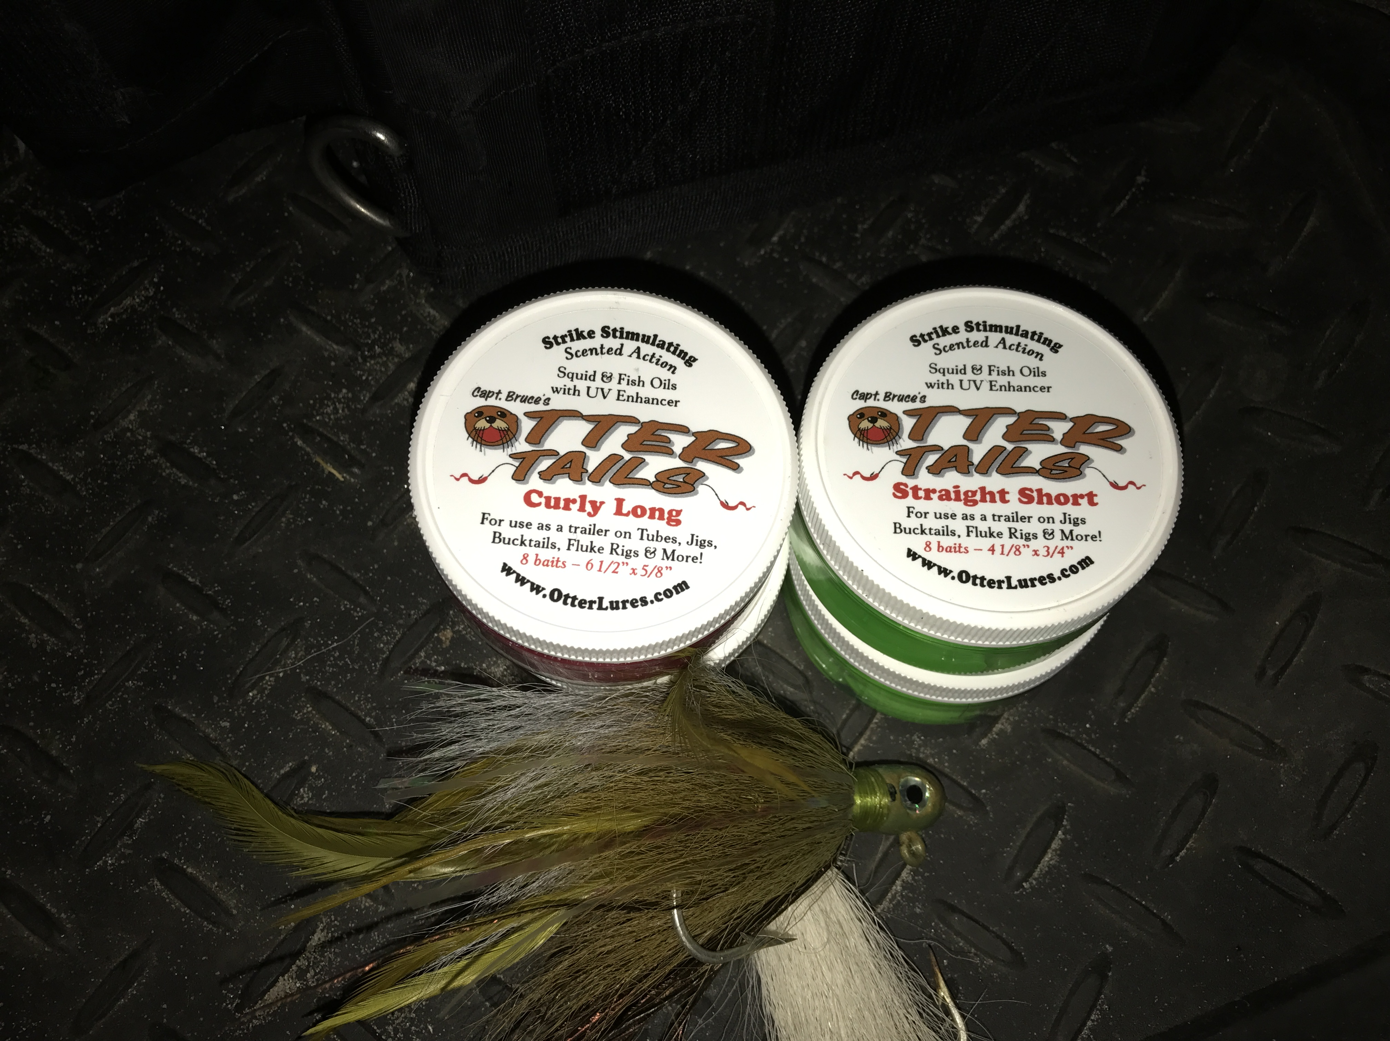
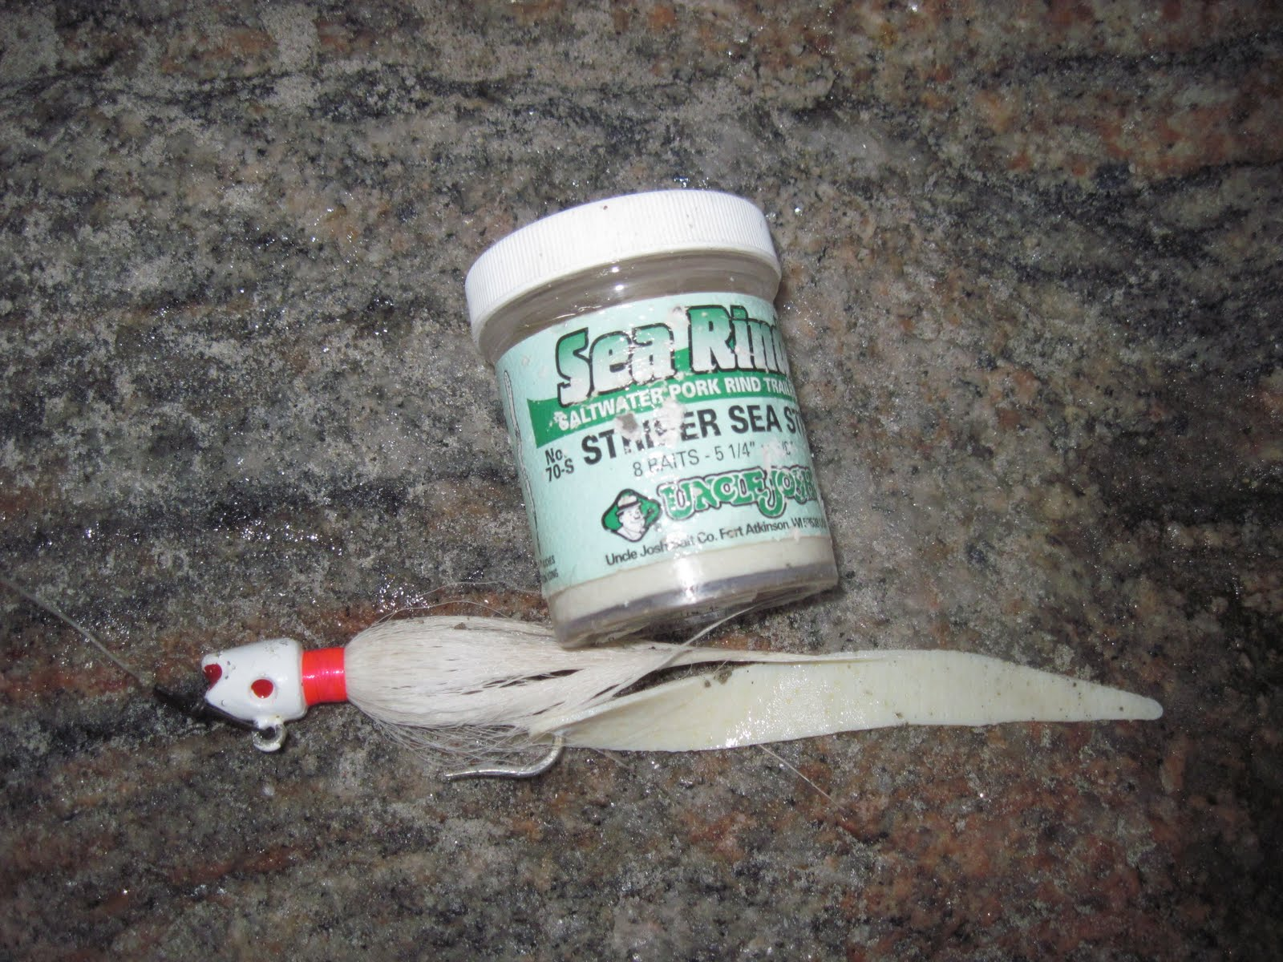
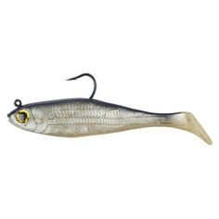
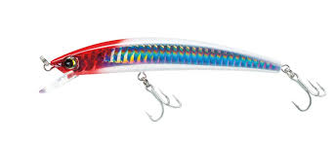
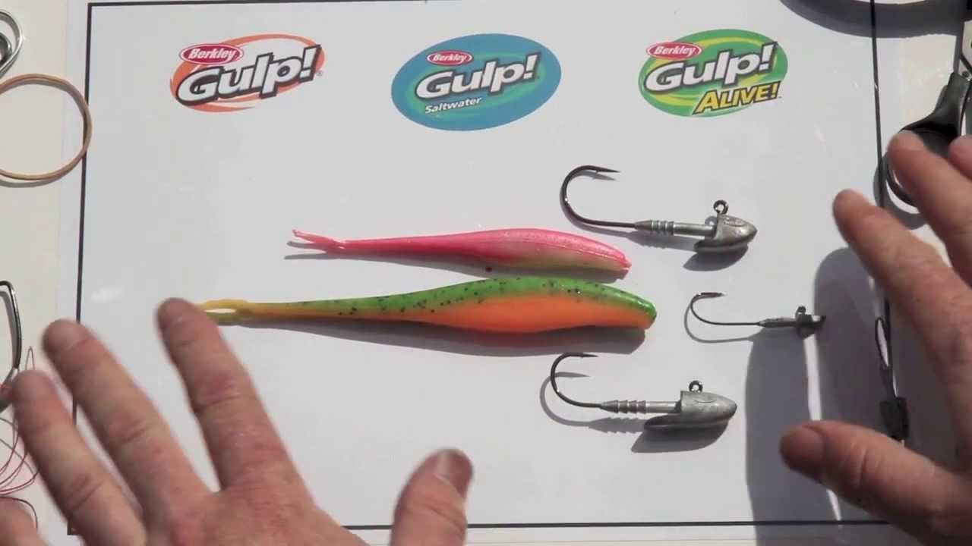
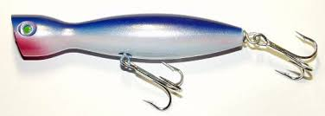
¾ oz to 1 oz
USING A BUCKTAIL
STORM
Yo Zuri
Snap Jigging
Super Strike
How To Pick and Use A Pencil Popper

Slide 7

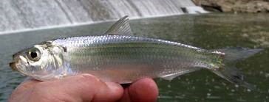
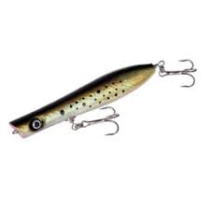
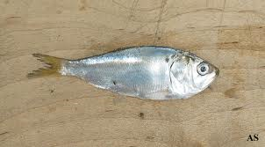
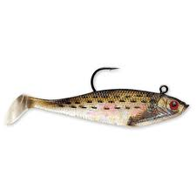
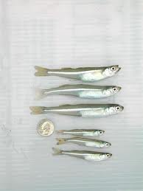
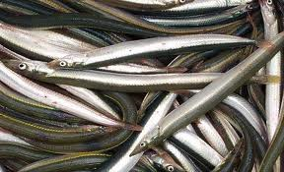

How To Pick Lures

Slide 8
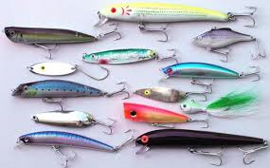
LURES TO HAVE

Slide 9
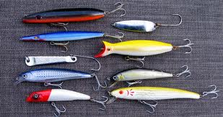
LURES TO HAVE

Slide 10
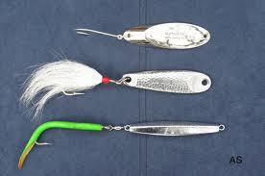
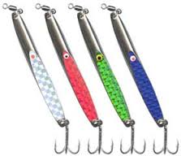
LURES TO ALWAYS HAVE

Slide 11
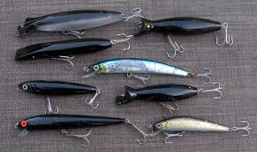
AND FOR AT NIGHT

Slide 12
NORTH SHORE Boat
Rods
  6’ to 7.5’ Medium to MH Action
Reels
  “15” or “6500” series sized reel (depends on brand and rod you choose)
Line
  20# to 40# test Lighter is easier to cast but when you have to turn a big girl….
Bait and Lures
  More on next page

Slide 13
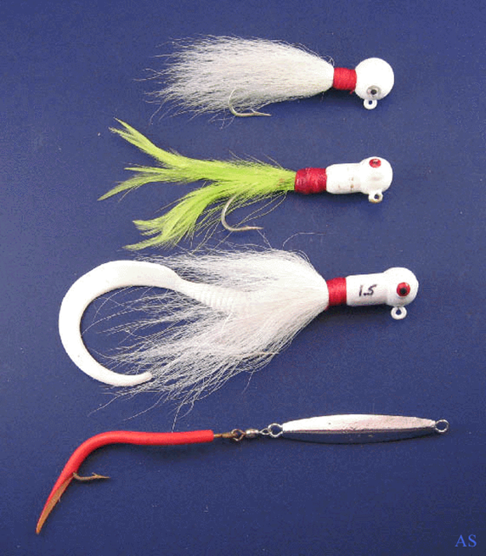
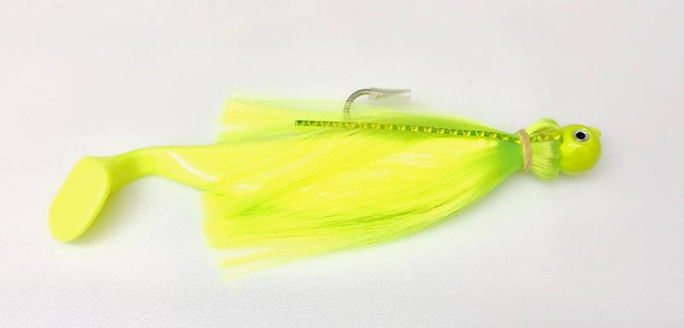
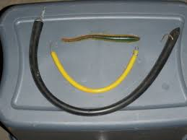
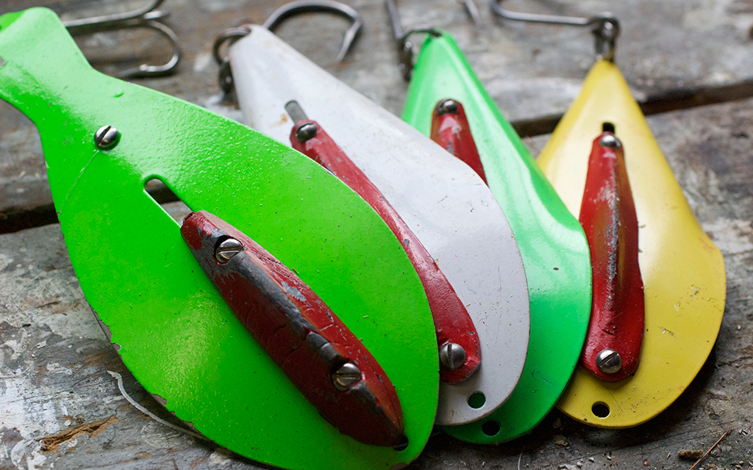
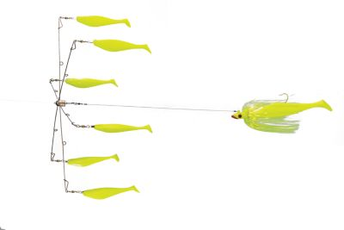
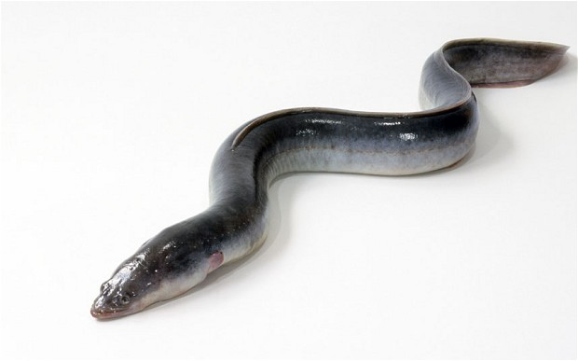
Lots of Same Lures as Previous
Trolling a tube

Slide 14
EAST END
Rods
  7’ to 8’ Rod MH to H action
Reels
  Depends on Rod but larger spool capacity and higher drag amounts
  “20” series or “7500”
Line
  30# to 50# test battling current and size
Bait and Lures
  More on next page

Slide 15
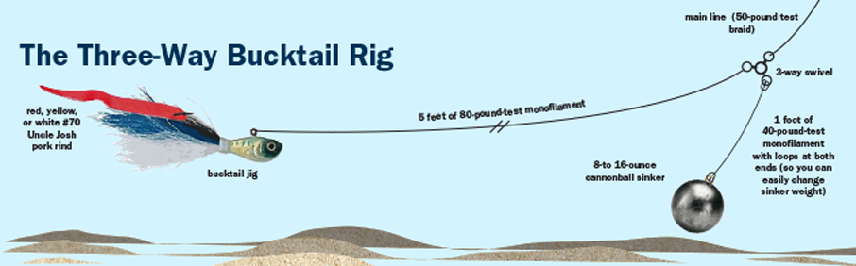
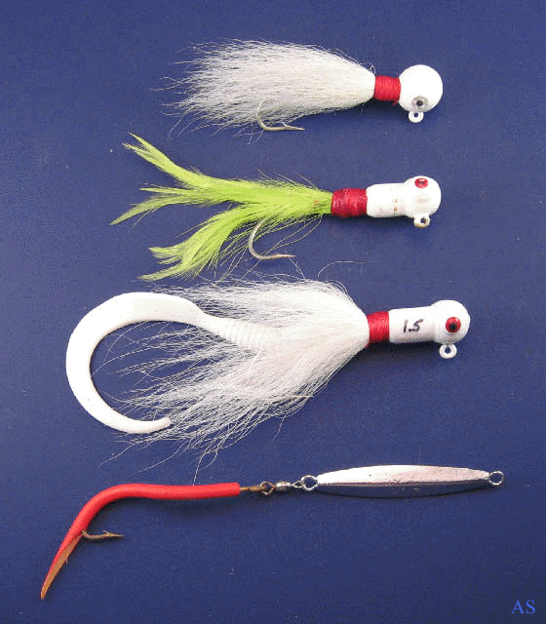

Slide 16
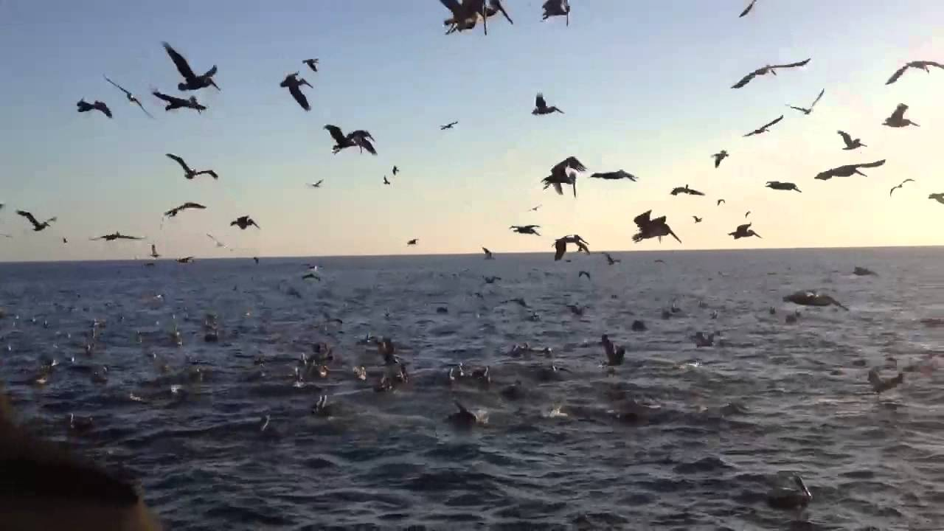
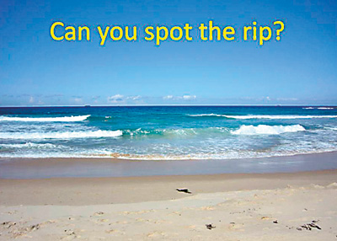
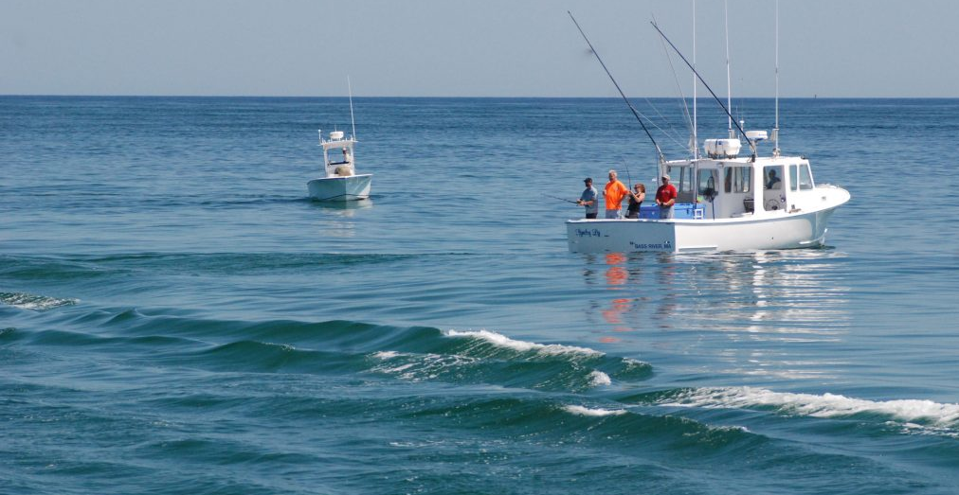
LETS TALK LOCAL SPOTS
Before I name any, here are some general rules to look for
BAIT
    Find the bait find the fish…..its that easy sometimes
    Bunker pods, birds “working”, large concentration of bait in an area
HEAVY CURRENT
    Stripers are powerful fish that take feeding opportunity….find the current!
RIPS
    See pic below…then #2 and eventually #4
STRUCTURE (such as rocks and sandbars or deep drop ledges)
    Ambush scenarios….predators are always opportune

Slide 17
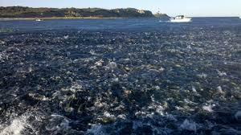
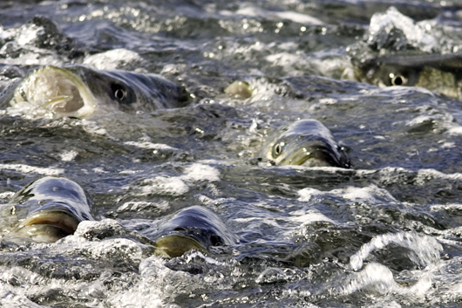
Dream
Situation

Slide 18
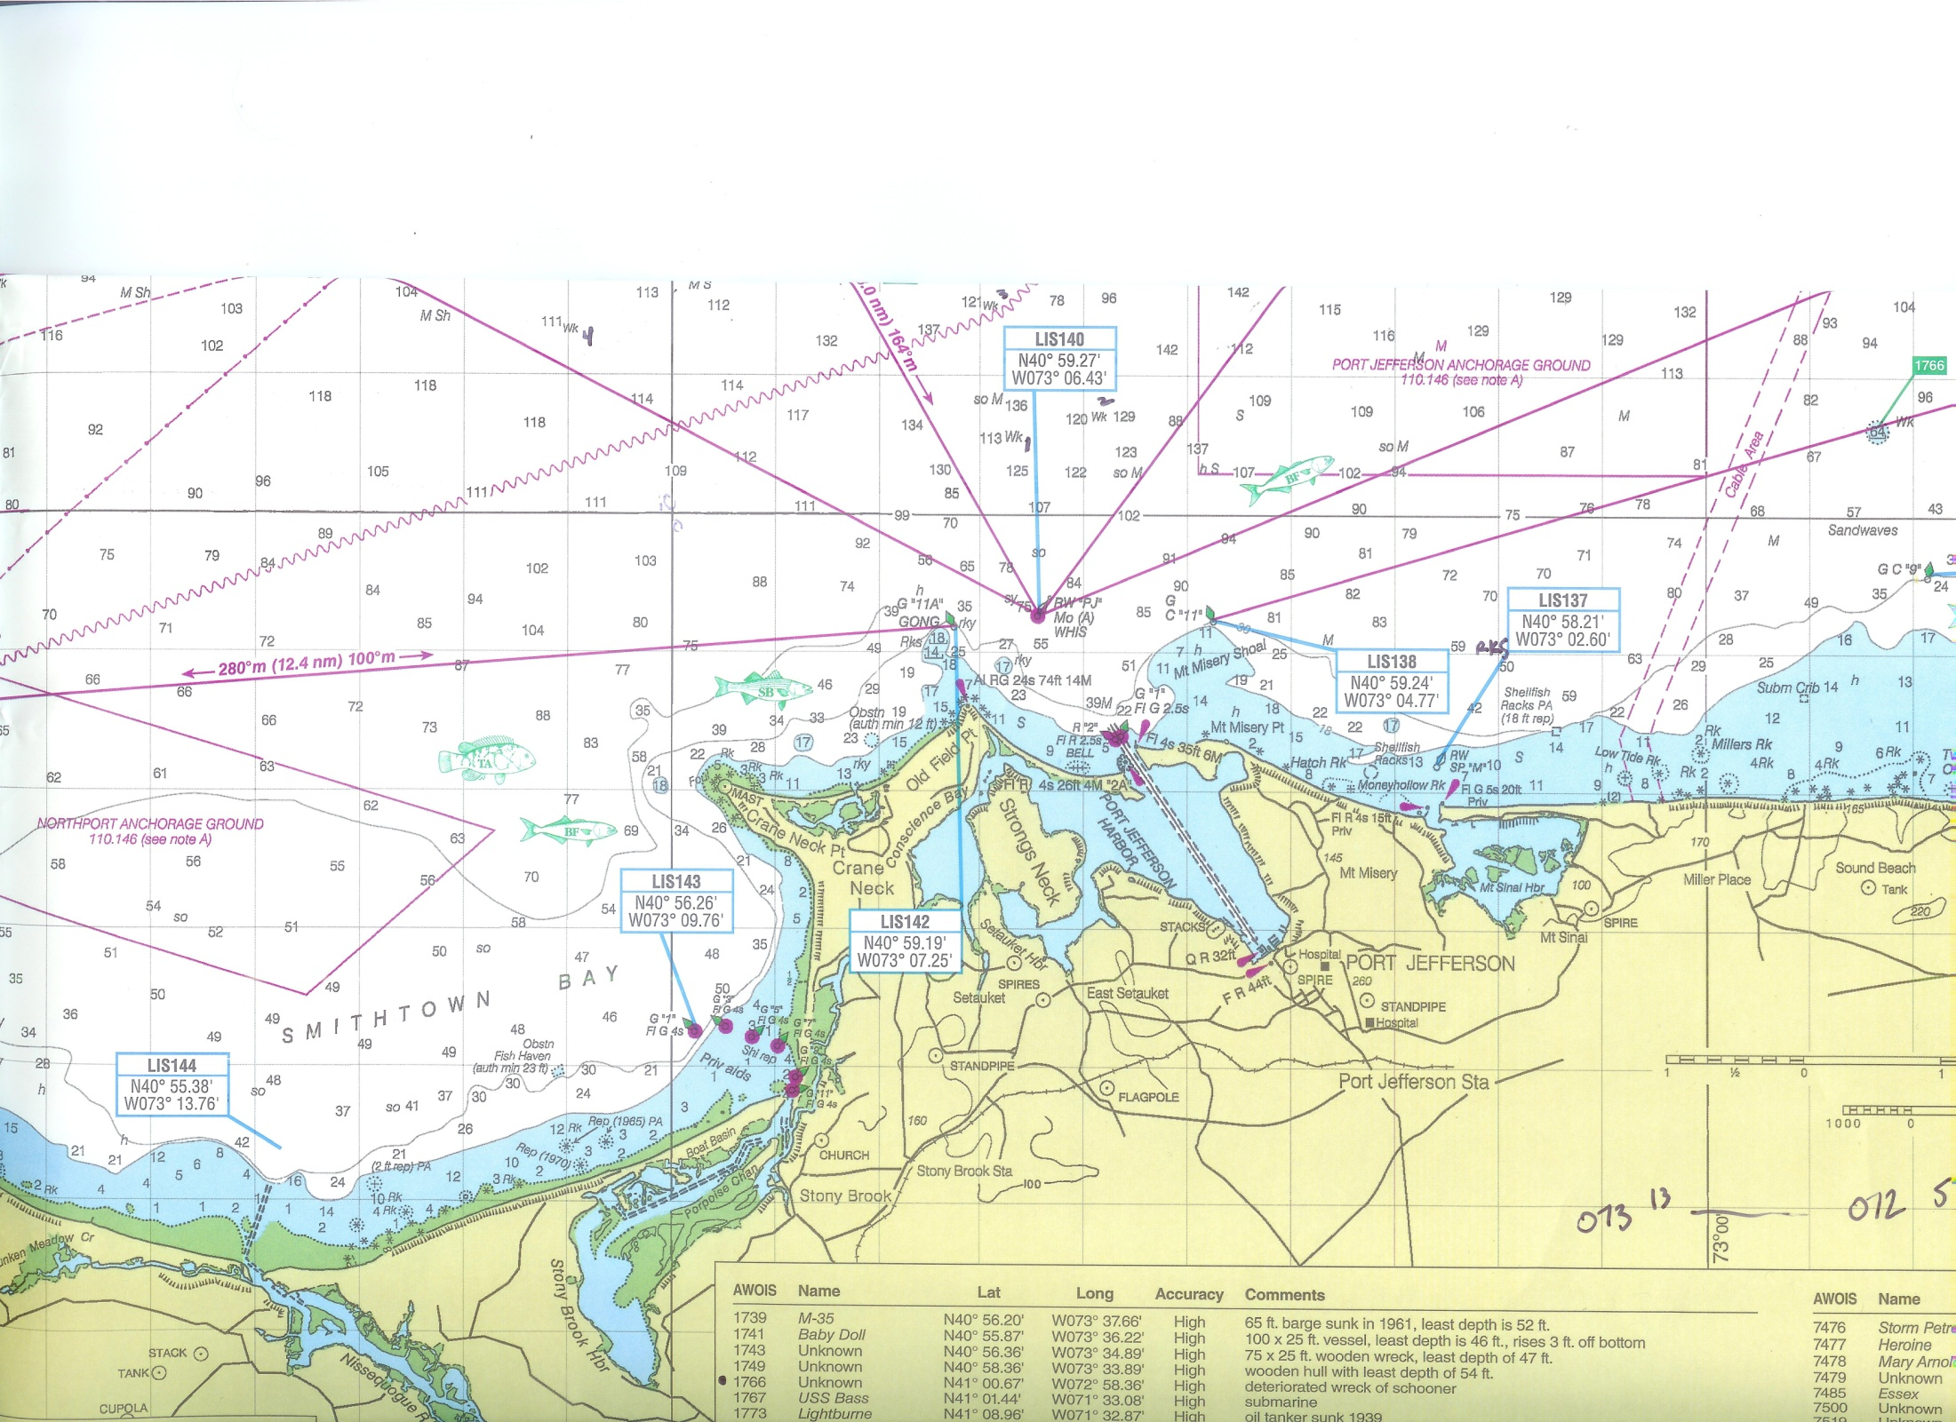

Slide 21
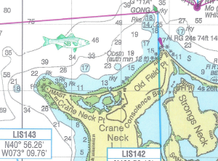
OLD Field PT to Cranes Neck

Slide 22
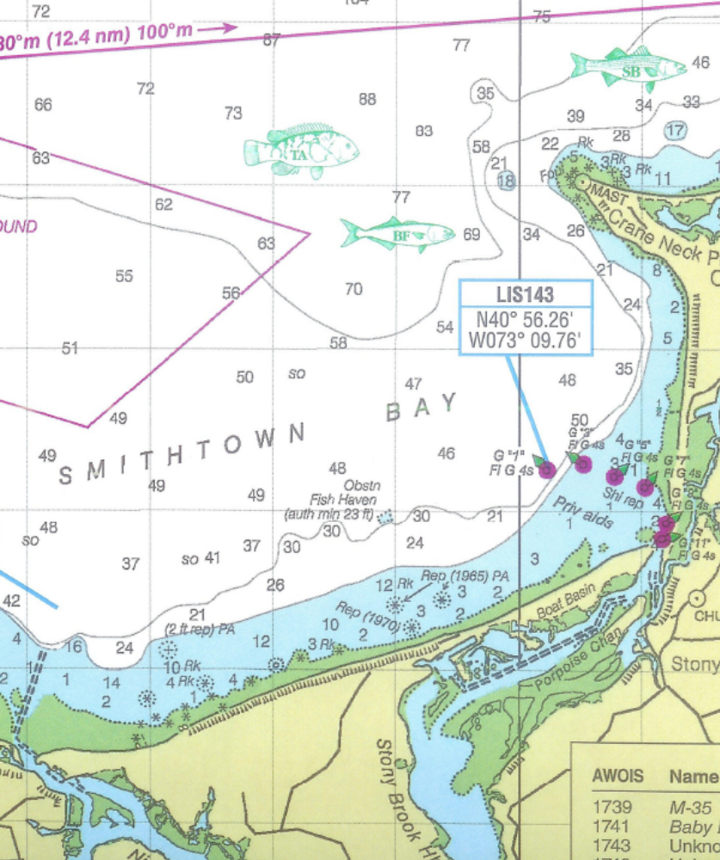
Smithtown Bay

Slide 23
